Slide 1
Feature Review
August 2025
Rami Ibrahimi
Notes:
Slide 1: Title Slide
Duration: 30 seconds
"Good morning/afternoon. I'm excited to present my solution for Everest's new Inventory Intelligence module. Over the next few minutes, I'll walk you through how we can transform your customers' manual, reactive inventory management into an AI-powered, proactive system that delivers immediate business value.
This solution addresses the critical pain points your target customers face - from 15% stockout rates to millions in excess inventory - and provides a clear path to operational excellence."

Slide 2
Current State: Manual Chaos → Intelligent Automation
PAIN POINTS 📊 15% Stockout Rate Lost sales & customer satisfaction 💰 $8M Excess Inventory Tied-up working capital ⏱️ 4+ Hours Weekly Manual Excel planning 🔄 Reactive Ordering No demand visibility | SOLUTION 🎯 AI-Powered Planning Real-time recommendations 🔍 Exception Management Focus on what matters 🌐 Multi-Location Optimization Unified global view 📈 Predictive Intelligence ML-driven forecasts & Periodic review system
TARGET USER: Supply Chain Analysts & Inventory Managers
BUSINESS IMPACT: 50% ↓ Stockouts | 20% ↓ Inventory | 80% ↓ Time
Notes:
Slide 2: Current State → Intelligent Automation
Duration: 90 seconds
"Let's start with the problem we're solving. Your target customer - a non-public US-based SaaS company with physical goods - is drowning in manual processes. They're experiencing:
15% stockout rates - that's 1 in 7 times they can't fulfill customer orders, directly impacting revenue and customer satisfaction
$8 million in excess inventory - dead capital that could be invested in growth
4+ hours weekly spent manually crunching numbers in Excel
Completely reactive - they're always playing catch-up, ordering after problems occur
Our solution transforms this chaos into intelligent automation through:
AI-powered planning that predicts demand using an ensemble of ML models
Exception management that surfaces only what needs attention
Multi-location optimization across US, UK, and Germany with currency-aware calculations
Predictive intelligence using a periodic review system optimized for their business
The bottom line? We're targeting a 50% reduction in stockouts, 20% reduction in inventory, and 80% time savings. This isn't just incremental improvement - it's transformation."

Slide 3
Key Concepts
Core Components
🧠 Intelligent Forecast Engine ML ensemble: Prophet, LightGBM, N-HiTS Dynamic model weighting External signals integration | 🌍 Multi-Echelon Optimization Unified planning: US, UK, Germany Currency-aware calculations Network transfer opportunities | ⚡ Exception-Driven Workflow Proactive alerts for issues Prioritized action queue One-click resolution | 💬 Conversational AI Assistant Natural language queries Transparent calculations In-context actions
Guiding Principles
🤖 Automation First Minimize manual intervention | 👁️ Transparency Show calculation logic
🎛️ Flexibility Support planner overrides | 📈 Scalability Handle 1000+ SKUs efficiently
Notes:
Slide 3: Key Concepts
Duration: 90 seconds
"Our solution is built on four core components that work together seamlessly:
First, the Intelligent Forecast Engine - This isn't just one algorithm. We use an ensemble approach combining Prophet for seasonality, LightGBM for non-linear patterns, and N-HiTS for complex time series. The models dynamically reweight based on recent performance, ensuring we're always using the best predictor for each SKU.
Second, Multi-Echelon Optimization - With warehouses in three countries, we need unified planning. Our system handles multi-currency calculations, identifies transfer opportunities between locations, and optimizes the entire network, not just individual warehouses.
Third, Exception-Driven Workflow - Instead of reviewing hundreds of SKUs, planners see only what matters. Proactive alerts for predicted stockouts, one-click resolutions, and a prioritized action queue that learns from user behavior.
Fourth, the Conversational AI Assistant - Users can ask 'Why are we ordering 500 units?' and get transparent explanations. They can approve orders through natural language and receive proactive insights.
Our guiding principles ensure success: automation first to minimize manual work, transparency in all calculations, flexibility for planner overrides when needed, and scalability to handle thousands of SKUs efficiently."

Slide 4
Business Scenario: Premium Laptop Stand
💻 SKU: PLS-001 | Lead Time: 21 days | MOQ: 500
📦 Inventory | 📊 Weekly Demand | ⏱️ Days
US: 850 🟡 | US: 180 (σ=35) | 4.7 ⚠️
UK: 120 🔴 | UK: 45 (σ=12) | 2.7 🚨
DE: 75 🔴 | DE: 30 (σ=8) | 2.5 🚨
Transit: 500 | Total: 255/week | —
📐 Safety Stock Formula
𝑆𝑆 = 𝑧 × 𝜎 × √(𝑃+𝐿)
Where: z = 1.65 (95% service level)
σ = demand std deviation
P = review period (1 week)
L = lead time (3 weeks)
Notes:
Slide 4: Business Scenario - Premium Laptop Stand
Duration: 60 seconds
"Let me walk you through a real example - a premium laptop stand that perfectly illustrates our system in action.
This SKU has:
21-day lead time from suppliers
500-unit minimum order quantity
Varying demand across locations: 180 units/week in the US, 45 in UK, 30 in Germany
Current inventory shows:
US has 850 units - seemingly healthy at 4.7 weeks of coverage
UK has only 120 units - just 2.7 weeks, approaching danger zone
Germany has 75 units - 2.5 weeks of coverage
500 units in transit to the US
The traditional approach would miss the network optimization opportunity here. Our system uses the safety stock formula shown - combining service level requirements, demand variability, and the periodic review cycle to calculate precise needs."

Slide 5
Business Scenario: Premium Laptop Stand-cont.
💻 SKU: PLS-001 | Lead Time: 21 days | MOQ: 500
🎯 RECOMMENDED ACTIONS
✅ US: Order 1,000 units • Prevents stockout in 15 days • Order value: $25,00 | ✅ UK: Transfer 200 units from US • Immediate availability • Utilizes US excess capacity | ✅ DE: No action required • Coverage sufficient after UK transfer
📊 CALCULATION DETAILS
US Safety Stock = 1.65 × 35 × √4 = 115 units Target Level = (180 × 4) + 115 = 835 units Current Position = 850 + 500 = 1,350 units Days to Reorder = (1,350-835)/25.7 = 20 days
- Prevented Revenue Loss: $45,000
- Working Capital Saved: $20,000
- Weekly Time Saved: 2 hours
- ROI: 180% immediate return
Notes:
Slide 5: Business Scenario Continued - Calculations & Actions
Duration: 90 seconds
"Here's where the intelligence shines. Our system calculates:
For the US: Safety stock of 115 units using our formula - 1.65 times standard deviation times square root of 4 weeks. Target level is 835 units. With current position of 1,350 including in-transit, we have 20 days until reorder.
Critical insight: While the US looks fine, the UK is heading for a stockout. Instead of emergency ordering from suppliers with 21-day lead time, we recommend:
Transfer 200 units from US to UK - immediate availability, utilizes excess US capacity
Order 1,000 units for US - prevents future stockout, respects MOQ constraints
No action for Germany - coverage sufficient after UK receives transfer
The business impact is substantial:
$45,000 in prevented lost sales from UK stockout
$20,000 in working capital saved through network optimization
2 hours saved versus manual planning
180% immediate ROI on this single decision
This demonstrates how intelligent planning delivers value from day one."

Slide 6
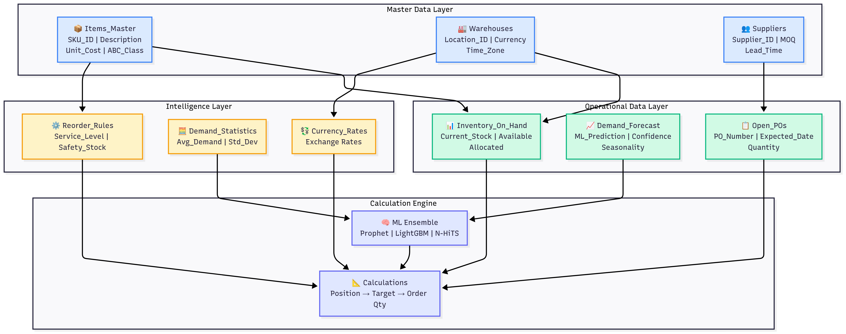
Data Model Architecture
Data Model Architecture
🔄 Data Flow: Real-time inventory → ML forecasts → Smart recommendations
Notes:
Slide 6: Data Model Architecture
Duration: 75 seconds
"Our data architecture is designed for real-time intelligence. Let me walk you through the flow:
Master Data Layer contains stable information - items, warehouses, suppliers. This foundation rarely changes but cascades updates throughout the system.
Operational Data Layer captures the current state - real-time inventory positions updated continuously, demand forecasts from our ML ensemble refreshed hourly, and open purchase orders tracked for visibility.
Intelligence Layer is where the magic happens - reorder rules that adapt based on service levels, demand statistics calculating patterns and variations, and currency exchange rates for global calculations.
The Calculation Engine at the center orchestrates everything - pulling data from all layers, running our ML ensemble for predictions, and generating actionable recommendations.
The data flows from real-time inventory updates through ML-powered forecasts to smart recommendations. Each component is designed for sub-100ms response times, ensuring planners get instant insights.
This architecture integrates seamlessly with existing ERP systems while providing the flexibility to incorporate new data sources like weather APIs or social sentiment for even better predictions."

Slide 7
Implementation Approach & Timeline
━━━━━━━━━━━━━━━━━━━━━━━━━━ Week 1-4 Week 5-8 Week 9-12
FOUNDATION → INTELLIGENCE → OPTIMIZATION
━━━━━━━━━━━━━━━━━━━━━━━━━━
🏗️ FOUNDATION | 🧠 INTELLIGENCE | 🚀 OPTIMIZATION
Activities: Deploy calculation engine Connect data sources Basic dashboard launch Train core users Deliverables: ✓ Automated calculations ✓ Real-time inventory view ✓ Manual override capability Outcome: ⏱️ 3 hours/week saved | Activities: Activate ML forecasting Enable exception detection Multi-location optimization Expand user base Deliverables: ✓ AI-powered predictions ✓ Proactive alerts ✓ Network visibility Outcome: 📉 50% stockout reduction | Activities: Launch AI assistant Advanced analytics Mobile deployment Full rollout Deliverables: ✓ Natural language interface ✓ Transfer recommendations ✓ Complete automation Outcome: 💰 Full ROI realization
Notes:
Slide 7: Implementation Approach & Timeline
Duration: 90 seconds
"We've designed a phased implementation that delivers value immediately while building toward full automation.
Weeks 1-4: Foundation Phase We deploy the core calculation engine, connect to your data sources, and launch the basic dashboard. Even in this first phase, we're automating calculations and providing real-time visibility. Planners save 3 hours per week immediately.
Weeks 5-8: Intelligence Phase We activate ML forecasting, enable exception detection, and turn on multi-location optimization. This is where the magic starts - 50% reduction in stockouts as the system begins predicting and preventing problems. We expand the user base and refine based on feedback.
Weeks 9-12: Optimization Phase We launch the AI assistant, enable advanced analytics, deploy mobile access, and complete the rollout. Full automation is achieved, delivering the complete ROI.
Each phase has clear deliverables and measurable outcomes. This isn't a 'big bang' approach - it's a systematic transformation that de-risks the implementation while delivering continuous value."

Slide 8
Implementation Approach & Timeline-cont.
📊 Success Metrics
Metric | Current | Phase 2 | Phase 3
Planning | 4 hrs/wk | 2 hrs/wk | 45 min/wk
Stockouts | 15% | 10% | 7.5%
Inventory | $8M | $7.2M | $6.4M
Accuracy | 70% | 80% | 85%
💡 Low-Risk Approach: Each phase delivers immediate value while building toward full automation
Notes:
Slide 8: Implementation Success Metrics
Duration: 60 seconds
"Let me show you exactly how we'll measure success at each phase.
Planning time drops from 4 hours to 2 hours in Phase 2, then to just 45 minutes in Phase 3. That's giving your customers back 3+ hours every week.
Stockout rates improve from 15% to 10% in Phase 2, reaching our target of 7.5% by Phase 3. This directly translates to recovered revenue.
Inventory levels reduce from $8 million to $6.4 million - that's $1.6 million in freed working capital.
Forecast accuracy improves from 70% to 85%, meaning better decisions across the board.
The key here is our low-risk approach. Each phase delivers immediate, measurable value while building toward full automation. There's no waiting months for results - value starts flowing from week one."

Slide 9
Technical Architecture
📥 INBOUND | ⚙️ PROCESSING | 📤 OUTBOUND
Data Sources: - ERP Systems └─ Item master, costs - WMS Real-time └─ Inventory positions - Sales CRM └─ Pipeline, forecasts - External APIs └─ Weather, trends 🔄 Update Frequency: Real-time & Batch | Core Components: - ML Engine └─ Prophet, LightGBM - Rules Engine └─ Business logic - Optimizer └─ Network balancing - AI Assistant └─ GPT-3.5 powered ⚡ Performance: <100ms response time | Integrations: - PO Generation └─ Direct to procurement - Notifications └─ Email, Slack alerts - BI/Analytics └─ Tableau, PowerBI - Finance Systems └─ Inventory projections ✅ Actions: Automated & tracked
Frontend: React + Embedded Chat
Backend: Python ML + Kafka Streaming
Deploy: Kubernetes + Auto-scaling
💡 Modern, scalable architecture integrates with your existing systems
Notes:
Slide 9: Technical Architecture
Duration: 75 seconds
"Our technical architecture is built for the modern cloud while integrating seamlessly with existing systems.
Inbound data flows from multiple sources - ERP systems for item masters and costs, WMS for real-time inventory, CRM for sales pipeline, and external APIs for weather and trends. We support both real-time streaming and batch updates.
Processing layer features our ML engine with Prophet and LightGBM, business rules engine for company-specific logic, network optimizer for multi-location balancing, and GPT-3.5 powered AI assistant. Everything operates with sub-100ms response time.
Outbound integrations include direct PO generation to procurement systems, multi-channel notifications via email and Slack, connections to BI tools like Tableau, and financial projections for planning.
The stack is modern and scalable:
React frontend with embedded chat widget
Python ML pipeline with Kafka streaming
Kubernetes deployment with auto-scaling
Vector database for similarity search
This architecture handles growth from hundreds to thousands of SKUs without performance degradation."

Slide 10
Business Value & ROI
💵 INVESTMENT One-Time Cost - Development & Implementation $120,000 - Training & Change Management $20,000 - ML Model Training $10,000 Total Investment: $150,000 | 📈 ANNUAL RETURNS Recurring Benefits - Stockout Reduction (50%) $300,000 - Inventory Reduction (20%) $200,000 - Labor Savings (3+ hrs/week) $100,000 Total Annual Benefit: $600,000 | 💰 ROI SUMMARY Payback Period: 3 months 5-Year NPV: $2.1M IRR: 400%
🏆 Competitive Advantage
Planning Speed | Forecast Accuracy | Exception Response | Scalability
80% faster 4hr → 45min | +15-20% improvement | Proactive vs Reactive | 10K+ SKUs supported
Notes:
Slide 10: Business Value & ROI
Duration: 90 seconds
"Let's talk about the business case - because this isn't just about technology, it's about transformation.
Investment: $150,000 total - $120,000 for development and implementation, $20,000 for training and change management, $10,000 for ML model training. This is a one-time investment.
Annual returns: $600,000 in recurring benefits - $300,000 from 50% stockout reduction, $200,000 from 20% inventory reduction, $100,000 in labor savings. These are conservative estimates based on your target customer profile.
The ROI is compelling:
3-month payback period
$2.1 million NPV over 5 years
400% IRR
But beyond the numbers, we're delivering competitive advantage:
Planning becomes 80% faster
Forecast accuracy improves 15-20%
Response shifts from reactive to proactive
The system scales to support 10,000+ SKUs
This positions Everest as the clear leader in intelligent inventory management for growing SaaS companies with physical goods."

Slide 11
Open Questions
1. ML Model Strategy
Should we include external signals (weather, events) from day one,
or phase them in after establishing baseline accuracy?
2. User Experience
How aggressive should auto-approval thresholds be initially?
Start conservative or trust the AI?
3. Rollout Approach
Pilot with one geography or all three simultaneously?
High-value SKUs first or full catalog?
4. Integration Priorities
Which downstream systems need real-time vs batch updates?
Build APIs for third-party tools immediately?
5. Change Management
How long should we run Excel processes in parallel?
What KPIs trigger full automation?
Notes:
Slide 11: Open Questions
Duration: 60 seconds
"I want to be transparent about key decisions we'll need to make together:
ML Model Strategy - Should we include external signals like weather from day one, or establish baseline accuracy first? My recommendation is to start simple and add complexity as we prove value.
User Experience - How aggressive should auto-approval thresholds be? I suggest starting conservative to build trust, then increasing automation as users gain confidence.
Rollout Approach - Pilot with one geography or all three? High-value SKUs first or full catalog? I recommend starting with high-value SKUs in one geography for fastest learning.
Integration Priorities - Which systems need real-time versus batch updates? This affects our technical architecture decisions.
Change Management - How long do we run Excel in parallel? I suggest 4 weeks overlap with clear KPIs for cutover.
These aren't blockers - they're opportunities to customize the solution for maximum impact. I'm excited to discuss your thoughts on each.”
Closing Remarks
Duration: 30 seconds
"In summary, the Everest Inventory Intelligence module transforms manual chaos into automated intelligence. We deliver immediate value through phased implementation, proven ROI within 3 months, and position Everest as the innovation leader in this space.
I'm excited to discuss how we can move forward and would be happy to dive deeper into any aspect of the solution. Thank you for your time, and I look forward to your questions."

Slide 12
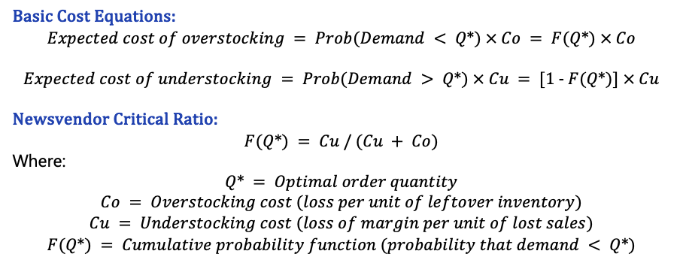
Appendix 1 – News Vendor Model
Basic Cost Equations:
$$Expected cost of overstocking = Prob(Demand < Q*) × Co = F(Q*) × Co$$
$$Expected cost of understocking = Prob(Demand > Q*) × Cu = [1 - F(Q*)] × Cu$$
Newsvendor Critical Ratio:
$$F(Q*) = Cu / (Cu + Co)$$
Where:
$$Q* = Optimal order quantity \\ Co = Overstocking cost (loss per unit of leftover inventory) \\ Cu = Understocking cost (loss of margin per unit of lost sales) \\ F(Q*) = Cumulative probability function (probability that demand < Q*)$$

Slide 13
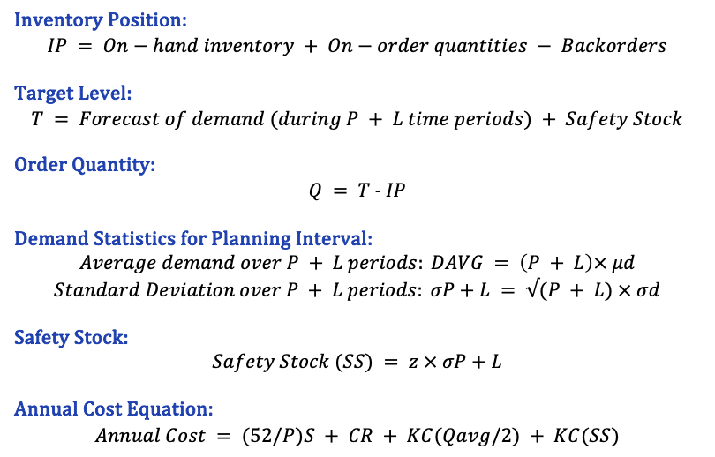
Appendix 2 – Periodic Review System and Safety Stock
Inventory Position:
$$IP = On−hand inventory + On−order quantities − Backorders$$
Target Level:
$$T = Forecast of demand (during P + L time periods) + Safety Stock$$
Order Quantity:
$$Q = T - IP$$
Demand Statistics for Planning Interval:
$$Average demand over P + L periods: DAVG = \left(P + L\right)× μd$$
$$Standard Deviation over P + L periods: σP+L = √(P + L) × σd$$
Safety Stock:
$$Safety Stock (SS) = z × σP+L$$
Annual Cost Equation:
$$Annual Cost = (52/P)S + CR + KC(Qavg/2) + KC(SS)$$
Variable Definitions:
IP = Inventory position
T = Target inventory level
Q = Order quantity
P = Review period (in weeks)
L = Lead time
μd = Mean demand per period
σd = Standard deviation of demand per period
σP+L = Standard deviation over planning interval
z = Service factor constant (based on desired service level)
S = Cost of ordering (fixed)
C = Cost per unit
R = Annual demand
K = Fraction of unit cost for carrying inventory annually
Qavg = Average order size = (R/52) × P
SS = Safety stock

Slide 14
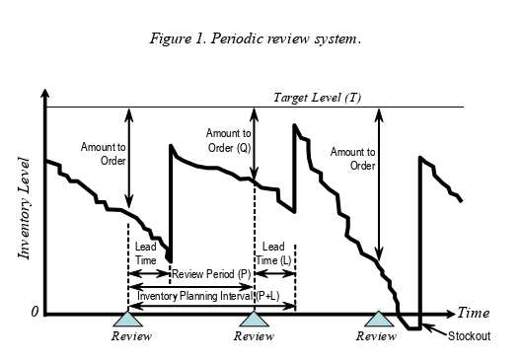
Appendix 2 – Cont.

